Slide 1
Neural networks in action
Content created by: Francesco Pinto, Linde Hesse, Tom Joy, Csabi Botos, Christina Winkler, Mélanie Roschewitz, Owais Hussain

Slide 2
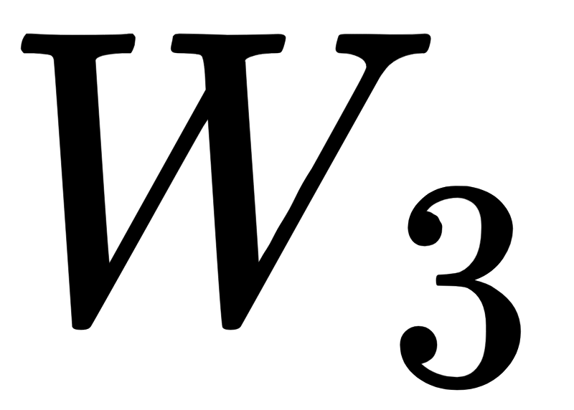

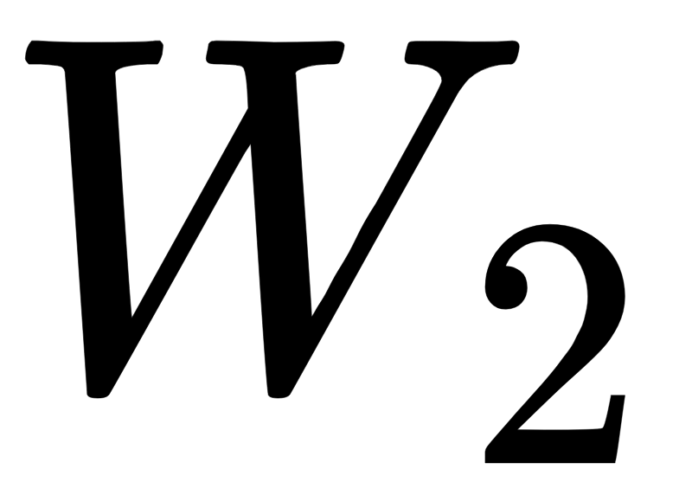
Designing a Neural Network
The design of a NN is called Network Architecture:
First layer is Input layer; the last on is Output layer.
All layers in the middle are hidden layers. For complex data and multi-class classification we can have many hidden layers.
The number of neurons per layer is called width.
We use Sigmoid as the Activation function for each neuron. However, there are many other functions we can use.
There is no hard-and-fast rule for choosing the number of hidden layers or the number of neurons per layer.
Notes:
What we should not do is have a single layer with too many neurons (inefficient), or too many layers with very few neurons each (unnecessarily iterative).

Slide 3
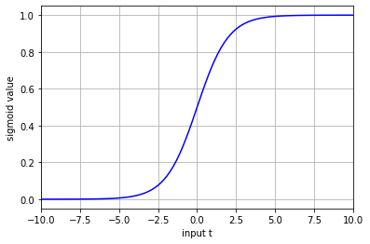
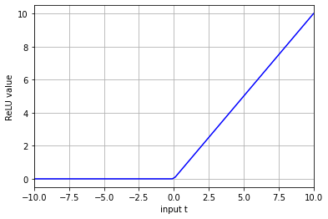
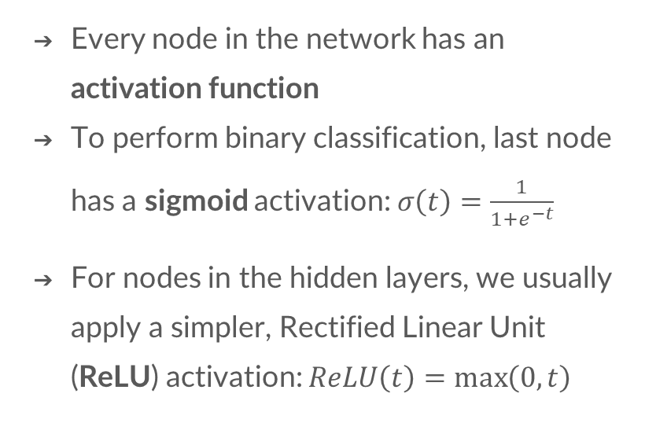
Activation functions
Every node in the network has an activation function
To perform binary classification, last node has a sigmoid activation: $σ\left(t\right)=\frac{1}{1+e^{−t}}$
For nodes in the hidden layers, we usually apply a simpler, Rectified Linear Unit (ReLU) activation: $ReLU\left(t\right)=\max\left(0,t\right)$
Notes:
ReLU is preferred for hidden layers because it trains deeper networks much more efficiently.

Slide 4
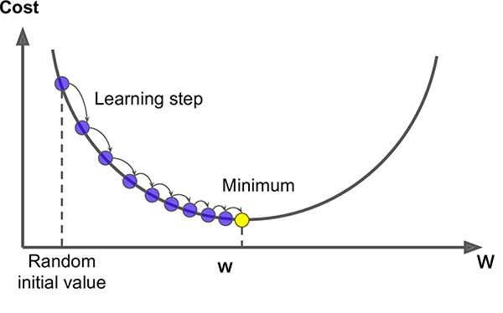
Training a Neural Network
As with logistic regression we need a loss function
We have seen that the Binary Cross-Entropy is well suitable for binary classification
We want to find weights that minimize this loss function
We can use gradient descent to iteratively update our weights to get the best loss value
By taking the gradient of our loss function we can determine the direction of the step
Our step size is determined by the learning rate

Slide 5
Implementing a neural network?
Objective 1: Sign-up on Kaggle.com to participate on first challenge.
Objective 2: Download Titanic dataset and load into a new Google Colab Notebook
Objective 3: Explore the dataset to understand the scenario
Objective 4: Train a multi-layered Neural Network

Slide 6
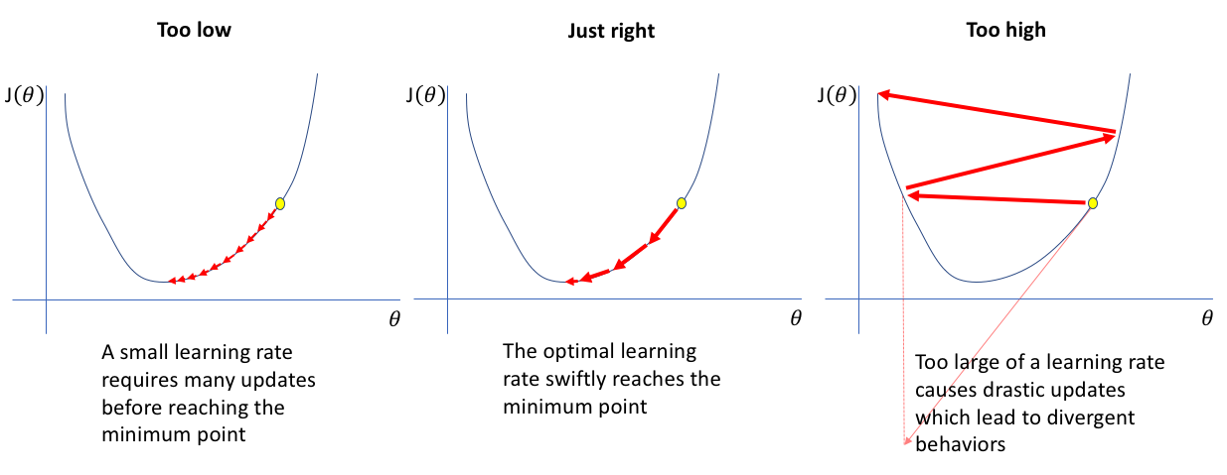
How does the learning rate impact training speed?

Slide 7
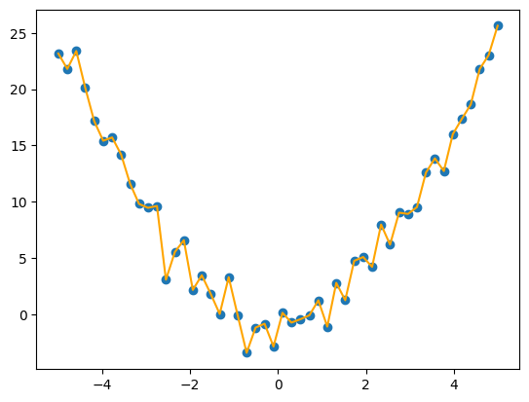
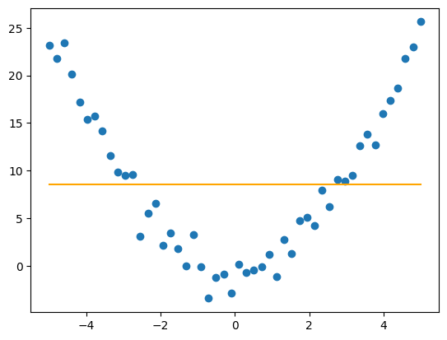
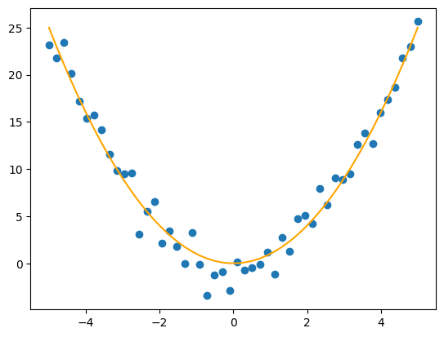
The bias-variance trade-off
Model is too complex, has ‘over-fitted’ to the training set
→ if we remove/add some training data points the model changes a lot → high variance
→ it makes no systematic mistake on the training set → low bias
Model is too simple, can not model the pattern in training data it is ‘under-fitting’
→ if we remove/add training points the model does not change → low variance
→ it makes systematic errors on the training data → high bias
Good model, balances well learn the pattern on the training data without over-fitting the noise in the training data.

Slide 8
The bias-variance trade-off
A neural network is extremely powerful.
If we have enough neurons / layers we can fit the training data perfectly…
But does this mean that we will do well at predicting un-seen test data?
We don’t only want to memorise the training data, we want to learn general patterns/trend in the data to make useful predictions.
If we are not careful we may over-fit.
That’s why it is super important to always measure the performance of the model on the TEST set and not on the training set.

Slide 9
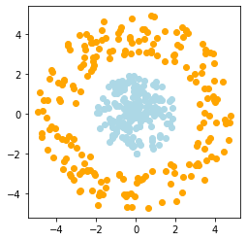

This week’s DIY
Classify the two circles dataset using a neural network using PyTorch library

Slide 10
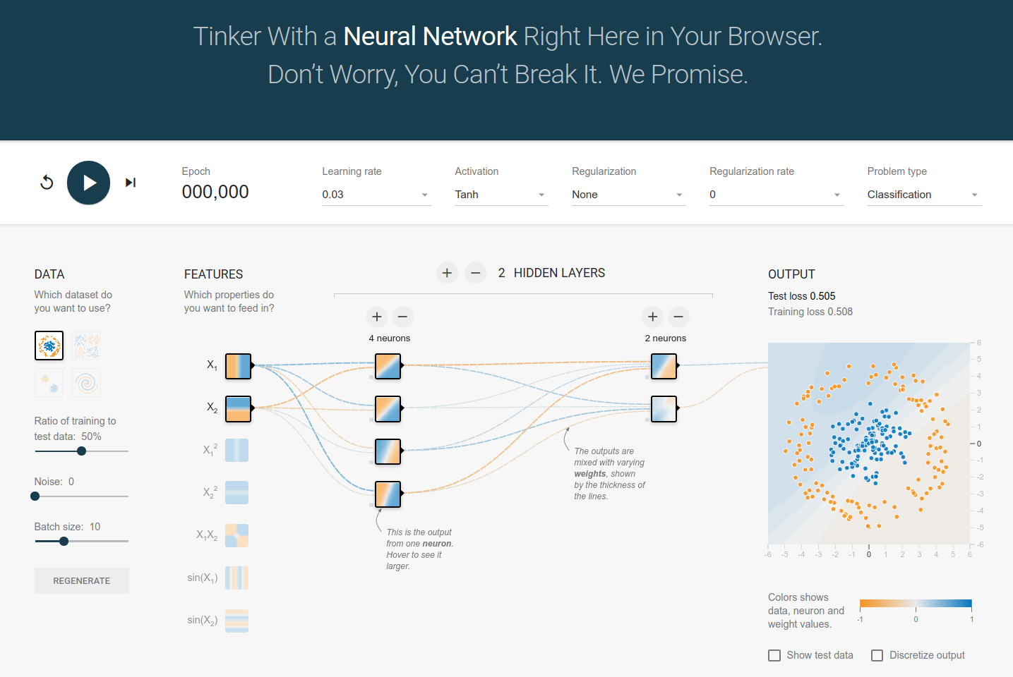
Thank you!
There are a lot of good additional resources online for understanding ML !
A good tool to play with the effect of your network design on the output can be found here.

